Slide 1
CCS2 – Workshop 8 Verification
4/30/2021

Slide 2
Verification in Research
Verification is the process of checking, confirming, making sure, and being certain.
In research, verification is the process to ensure the reliability and validity and, thus, the rigor of a study [1].
[1] Morse, Janice M., et al. "Verification strategies for establishing reliability and validity in qualitative research." International journal of qualitative methods 1.2 (2002): 13-22.

Slide 3
Things to verify
Experiment Setup
Approach/
Method/
Algorithm
valid? unbiased?
Result Presentation
Dataset
valid? balanced?
unbiased?
valid?
Experiment Result
valid?

Slide 4
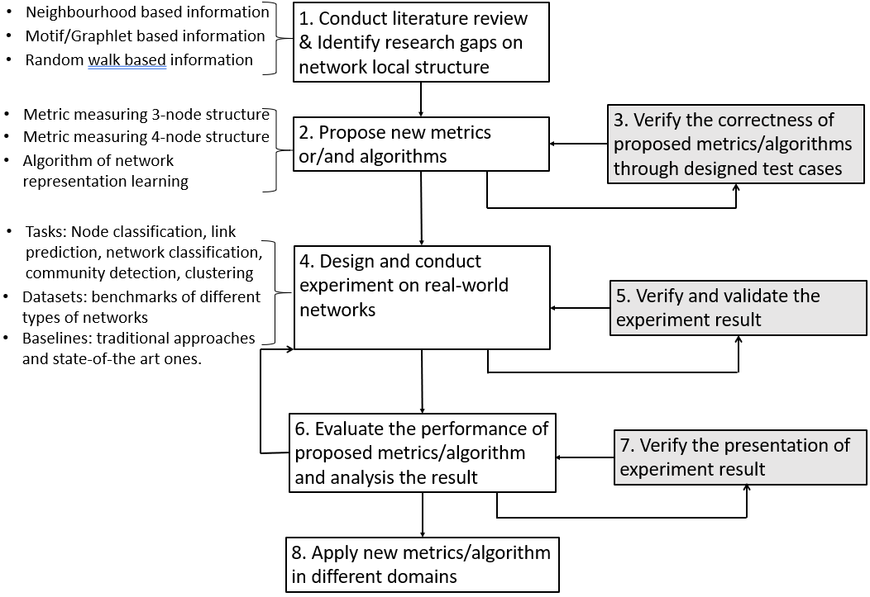
Verification in Research Methodology

Slide 5
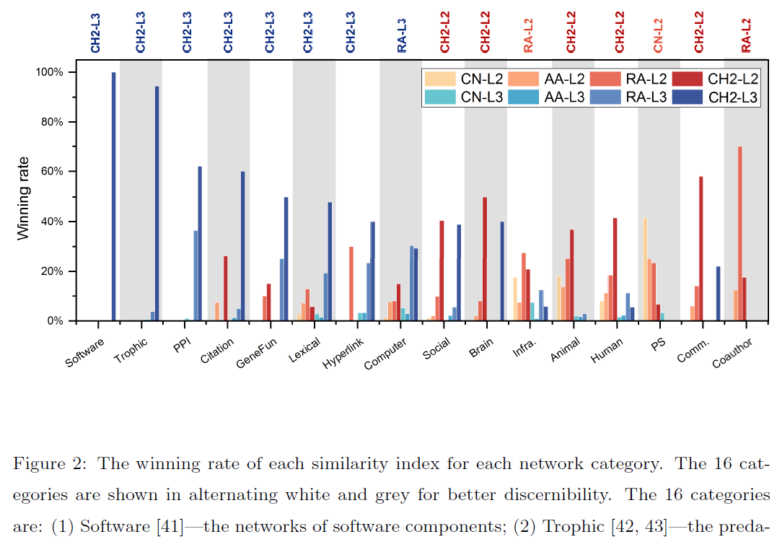
Example: Unbalanced datasets
2
23
20
3

Slide 6
Example: Invalid result

Slide 7
Activity 1 Verification and Validation Protocol
Group
40 mins
Based on your experiment result (approach), create a list of things you plan to verify
How to verify that your approach is valid?
How to verify that your experiment setup is valid and unbiased?
How to verify that your dataset is valid (and balanced)?
How to verify that your experiment result is valid?
How to verify that your presentation of result is unbiased?
Share your workings on Canvas

Slide 8
Activity 2 Feedback on Verification Plan
Between groups
20 mins
Each group provides some feedbacks on another group’s verification plan.
Comment on canvas
Undecided
The Lost Men
HD Coins
Faceless
Memento
Group 4

Slide 9
Activity 3 What is a good verification plan
Group
20 mins
Create a list of main characteristics that a good verification plan should have.
Activity 4 Assess your verification plan
Group
20 mins
Assess which characteristics of "a good verification and validation protocol" your plan has.
Revise your verification plan.

